Slide 1
DevOps

Slide 2
Agenda
Why DevOps?
What is DevOps?
DevOps Market Trends
DevOps Engineer Skills
DevOps Delivery Pipeline
DevOps Ecosystem

Slide 3
Why DevOps?

Slide 4
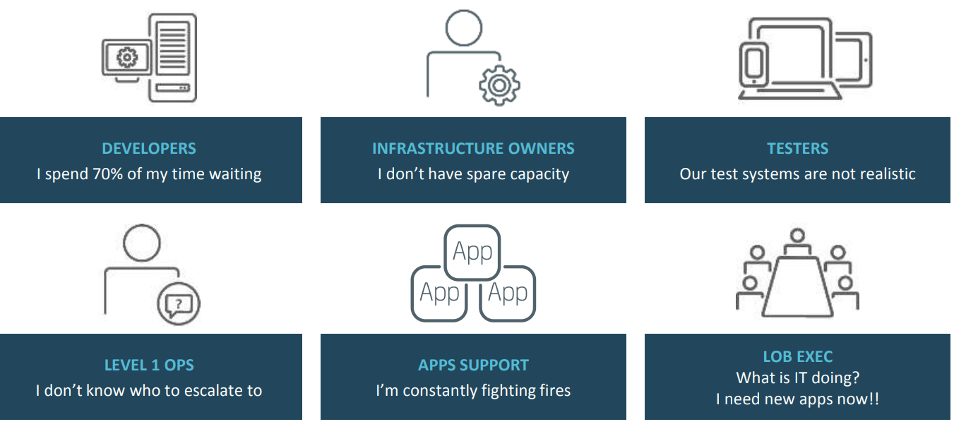
-- Delivery Challenges

Slide 5
Why Gaps?
Dev View:
Mostly delivers features after testing in development systems
Dev system may not be same as production systems
Developers will have faster turn around time for features
Not much concerned about the infrastructural as well as deployment impacts because of the code changes
Ops View:
Worries more about stability
Rewarded mainly for uptime.
Lesser turn around time new features deployment and testing due to large number of dev builds coming their way.
Very much concerned about the infrastructural as well as deployment impacts because of the code changes.

Slide 6
What Is DevOps?
Its about product not project.

Slide 7
What is DevOps?
DevOps (A combination of development and operations ) is a software development method that stresses communications, collaboration and integration between software developers and information technologies(IT) professionals thereby
Enable rapid evolution of products or services
Reduce risk, improve quality across portfolio, and reduce costs.

Slide 8
What is DevOps?
Dev Team
QA Team
DevOps is not a new technology or a product. It's an approach or culture of SW development that seeks stability and performance at the same time that it speeds software deliveries to the business. We will discuss this cultural shift where development teams have to accept the feedback of operations teams and the operations team should be ready to accept frequent updates to the SW that it's running.
Ops Team
DevOps

Slide 9
DevOps collaboration targets product delivery, quality testing, feature development and maintenance releases in order to improve reliability and security and faster development deployment cycles
The adoption of DevOps is being driven by factors such as:
Use of agile and other development processes and methodologies
Demand for an increased rate of production releases from application and business stockholders
Wide availability of virtualized and cloud infrastructure from internal and external providers
Increased usage of data center automation and configuration management tools

Slide 10
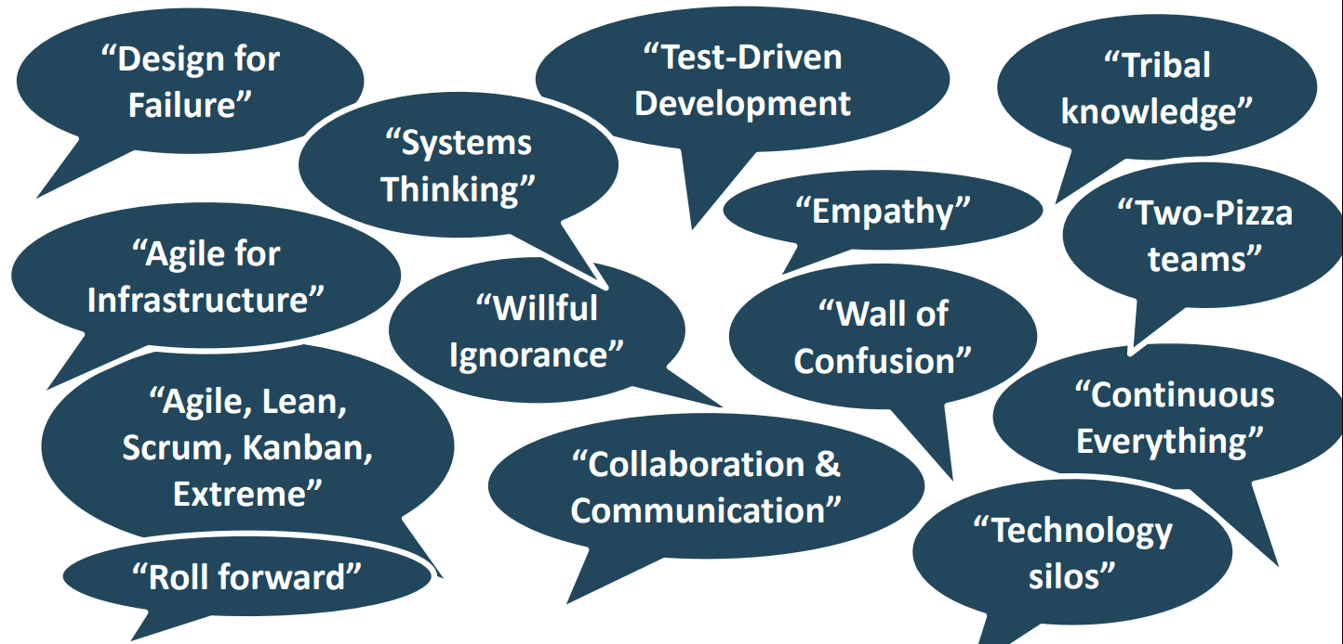
DevOps Culture: Patterns & Anti-Patterns

Slide 11
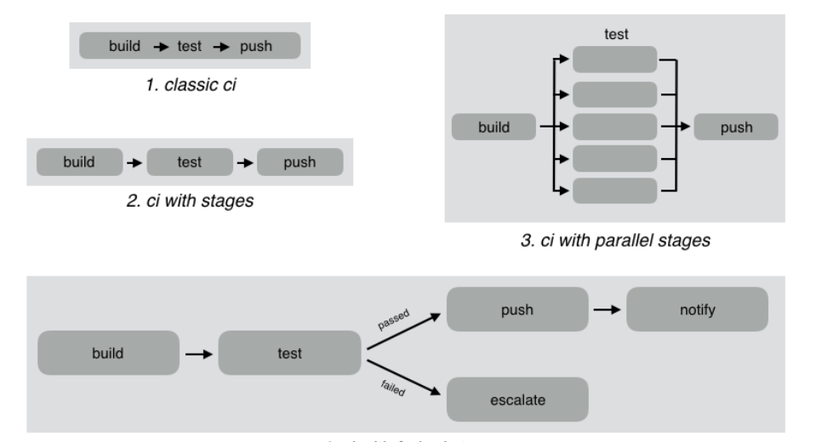
Continues Integration

Slide 12
DevOps Market Trends

Slide 13
DevOps Trends 2020
Automation Will Become the Major Focus
Shifting Attention from CI Pipelines to DevOps Assembly Lines
The Rise in Artificial Intelligence (AI), Data Science Boost
Concept of “Everything as Code”
Hype in Using Serverless Architecture
Automation Through AI and Data Science
More Embedded Security
Kubernetes has evolved significantly

Slide 14
DevOps Engineer Skills
Strong Communication and Collaboration Skills
Empathy and Unselfishness
Understanding of Major DevOps Tools
Software Security Skills
Command of Automation Technologies and Tools
Coding and Scripting Skills
Cloud Skills
Testing Skills
Customer-Centric Mindset / Product oriented mindset
Passion and Proactivity

Slide 15
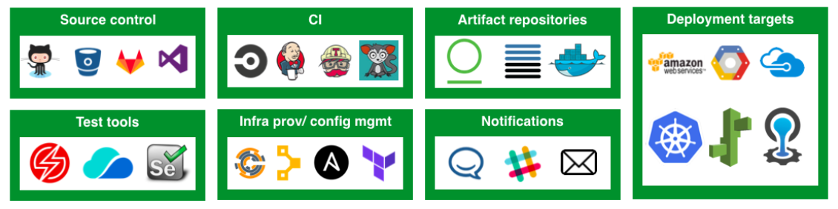
DevOps Delivery Pipeline
DevOps Assembly Lines

Slide 16
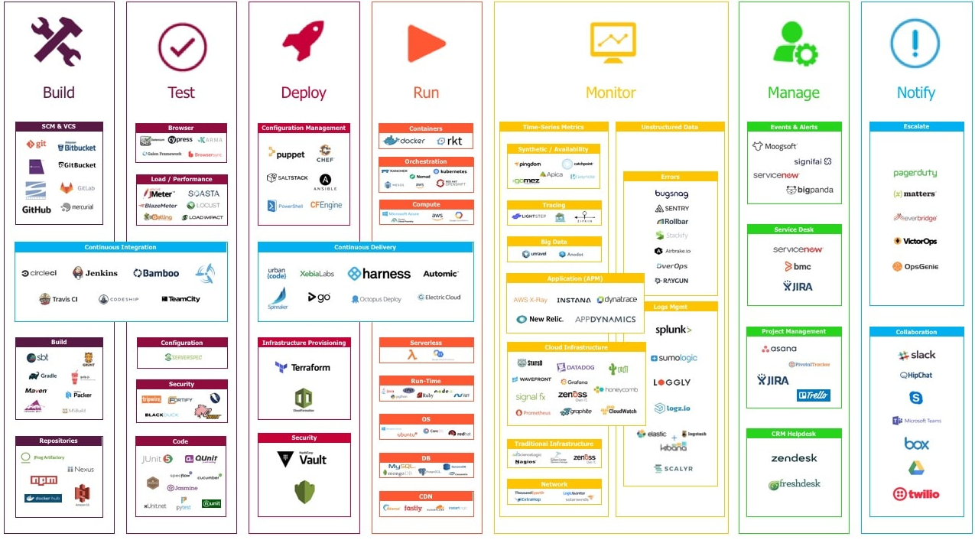
DevOps Ecosystem

Slide 17
Q & A

